Slide 1
Back to School Night
Mrs. ERICA Valente, M.ED
English teacher

Slide 2
Background
Rutgers BA
William Paterson M.Ed
Reading Specialist
English teacher at PAHS for 9 years
This year I am teaching:
  AP Literature & Composition
  English 4 Honors
  Young Adult Literature 2

Slide 3
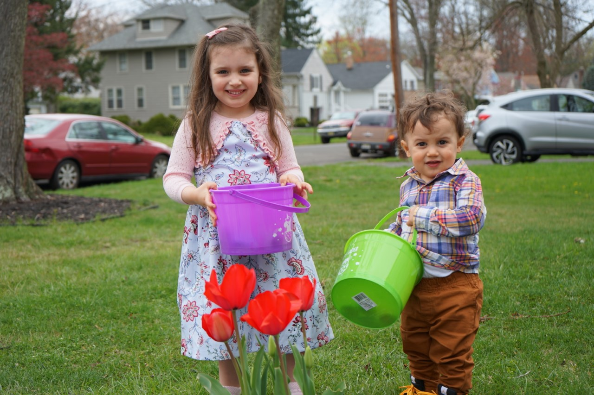
About me:
Avid reader
Love to travel
Mom to two little ones (4 and 2)
Parents immigrated from Spain (fluent in Spanish)

Slide 4
Contact Info:
Email is the best way to contact me – EricValente@paps.net
Remind: All classes have a unique Remind.com code that can be used to send/receive messages via cell phone. Please have your son or daughter share the codes with you, if necessary.

Slide 5
Virtual Class Expectations
Cameras must always be on
You must show your face on camera throughout the entire class period
No recording or taking pictures during class time
Stay on mute unless called on / use the chat feature to ask to use the bathroom etc.
All assignments are to be submitted through Google Classroom.
If you wouldn't do it in the classroom, don't do it on the google meet :)
Be respectful to your teacher and your fellow students.

Slide 6
Grading Policy
The Grading Policy for all courses at PAHS is as follows:
  60% - Assessments (tests, quizzes, essays, projects)
  35% - Classwork
  5% - Homework
  Notes:
  I will very rarely give homework during virtual schooling (unless it's reading)
  Not having your camera on and focused on your face will result in a reduced classwork grade.

Slide 7
Class Syllabi
AP Literature & Composition Syllabus
English 4 Honors Syllabus
Young Adult Literature 2 Syllabus

